Slide 1

emlearn
Machine Learning for Microcontrollers
Jon Nordby, Soundsensing
Notes:
Hi everyone,
and welcome to this microtalk about Machine Learning for microcontrollers,
and quick introduction to the emlearn open-source software package.
My name is Jon Nordby, and I am the Head of Data Science at Soundsensing.
We are a leading provider of Predictive Maintenance solutions for buildings and ventilation systems.

Slide 2
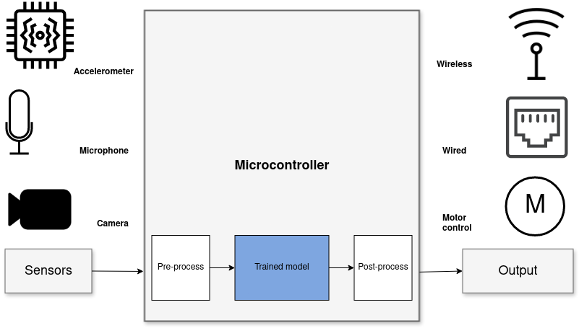
Sensor data analysis with Machine Learning
Benefits
Stand-alone
Low latency
Power efficiency
Privacy
Easy to consume
Notes:
Machine Learning is applied in more and more fields,
covering a very diverse set of applications.
When it comes to Machine Learning on microcontrollers,
we are obviously not going to be running any Large Language Models or generative image models.
But one usecase where ML is incredibly useful is in analysing sensor data.
Sensors such as accelerometers, microphonones, radars, and cameras have gotten incredibly cheap and powerful.
But in order to get useful information out of these, the raw data must be processed.
Using Machine Learning, in combination with Digital Signal Processing, allows analyzing complex phenomena.
If this is done on the microcontroller, we get a range of benefits:
...
The component in blue is the Machine Learning model,
and is typically trained ahead of time on a PC.

Slide 3
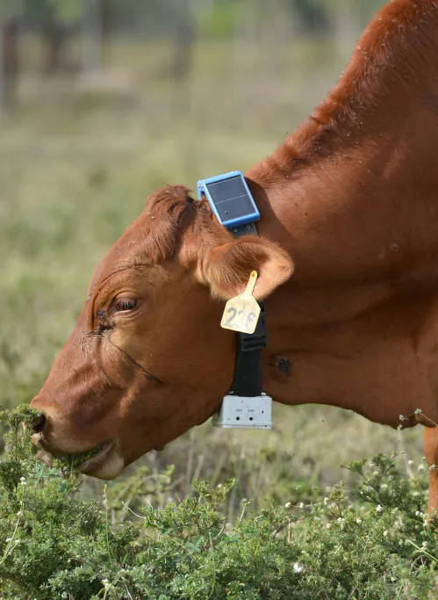

Example project
Cattle activity tracking using accelerometer
Activity data used to detect abnormal behavior, can indicate health issues or other problems
Classified using a Decision Tree lying/walking/standing/grazing/ruminating
Activity is transmitted using LoRaWAN
Running ML on-sensor: under 1 mW
50 times lower power than sending raw data
Power Efficient Wireless Sensor Node through Edge Intelligence
Abhishek Damle (2022)
Notes:
Here is an example of a practival project:
Analysing cattle activity using an accelerometer.
A decision tree model is used to analyze the accelerometer data,
and classify into lying/walking/standing/grazing/ruminating.
These categories are very compact and are transmitted over LoRaWAN.
And the data over time can be used to detect abnormal behavior,
which can indicate health issues, external threats or stressors.
They found that running the Machine Learning on-sensor
uses 50 times less power than transmitting raw data.
Giving a huge increase in battery life.

Slide 4

emlearn - Machine Learning for microcontrollers
https://github.com/emlearn/emlearn/
Convenient training
Embedded Friendly
Model creation in Python
Use standard libraries
scikit-learn
Keras
One-line to export to C
Verification tools included
Portable C99 code
No dynamic allocations
Header-only
High test coverage
Integer/fixed-point math *
libc optional *
Small. 1 kB+ FLASH
* Only some models
Notes:
emlearn is an open-source software library that can be used to implement such projects.
It provides embedded friendly implementations of Machine Learning models.
It supports converting models trained in Python, the most popular programming languge
for ML / Data Science projects.
Can either use scikit-learn or Keras, two very established frameworks.
The code is portable and clean C99.
It can be used on even the smallest MCUs,
as it does not need FPU, and the code size is very small.

Slide 5
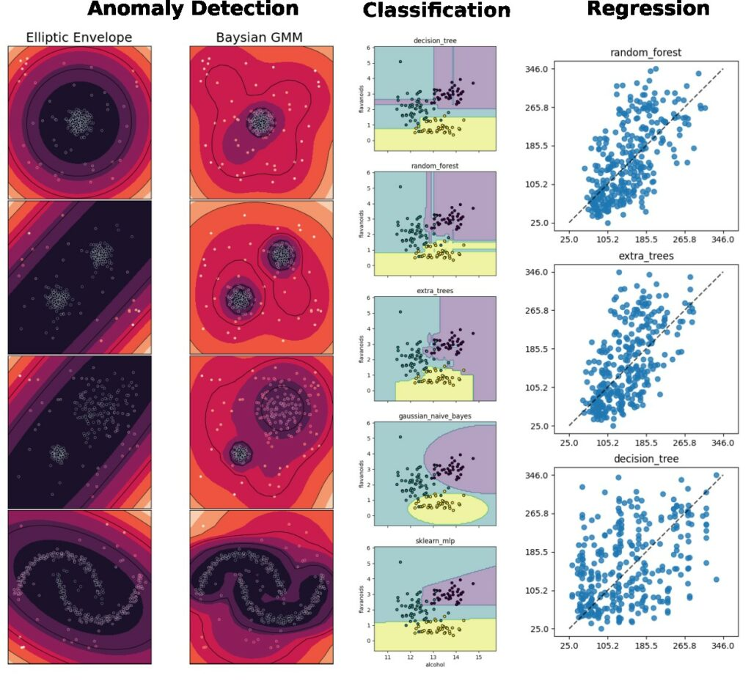
Supported tasks & models
Supports the most common tasks
Selection of simple & effective embedded-friendly models
“Classic” ML
Decision Trees (DT)
Random Forest (RF)
K Nearest Neighbors (KNN)
Gaussian Mixture Models (GMM)
Neural networks
Multi-Layer-Perceptron (ML)
Notes:
emlearn supports the three most common ML tasks:
classification, regression, anomaly detection.
Supports a selection of embedded friendly models:
Tree-based ensembles, K Nearest Neighbors and Neural Networks

Slide 6
How to use emlearn
0. Install the library
1. Train model in Python 2. Convert model to C code 3. Use the C code
Install as Python package (PyPI)
pip install emlearn
Install as git submodule
git submodule add https://github.com/emlearn/emlearn/
Notes:
Now we will quickly show how to use emlearn.
The library can be installed either as a Python package,
or be included as a git submodule.

Slide 7
Training a model
Using standard Python ML libraries.
from keras import …
model = Sequential([
Dense(16, input_dim=n_features, activation='relu'),
Dense(8, activation='relu'),
Dense(1, activation='sigmoid'),
])
model.compile(....)
model.fit(X_train, Y_train, epochs=1, batch_size=10)
from sklearn.ensemble import RandomForestClassifier
model = RandomForestClassifier(n_estimators=10, max_depth=10)
model.fit(X_train, Y_train)
B) scikit-learn Random Forest
from sklearn.neural_network import MLPClassifier
model = MLPClassifier(hidden_layer_sizes=(100,50,25))
model.fit(X_train, Y_train)
keras neural network
C) scikit-learn neural network
Notes:
Training a model is done using a standard framework like scikit-learn or keras.
You will need to already have a dataset collected and labeled for your task.
There is nothing emlearn specific at this point
- although you should use a model small enough to fit on your target device.
We also provide some tools for checking this.
Once you have a trained model, you are ready to deploy it to the device.

Slide 8
Convert model to C
Using emlearn.convert() and .save()
Takes the trained model from previous step
#include <eml_net.h>
static const float mynet_layer_0_biases[8] = { -0.015587f, -0.005395f, -0.010957f, 0.015883f ….
static const float mynet_layer_0_weights[24] = { -0.256981f, 0.041887f, 0.063659f, 0.011013f, …
static const float mynet_layer_1_biases[4] = { 0.001242f, 0.010440f, -0.005309f, -0.006540f };
static const float mynet_layer_1_weights[32] = { -0.577215f, -0.674633f, -0.376140f, 0.646900f, …
static float mynet_buf1[8];
static float mynet_buf2[8];
static const EmlNetLayer mynet_layers[2] = {
{ 8, 3, mynet_layer_0_weights, mynet_layer_0_biases, EmlNetActivationRelu },
{ 4, 8, mynet_layer_1_weights, mynet_layer_1_biases, EmlNetActivationSoftmax }
};
static EmlNet mynet = { 2, mynet_layers, mynet_buf1, mynet_buf2, 8 };
int32_t
mynet_predict(const float *features, int32_t n_features)
{
return eml_net_predict(&mynet, features, n_features);
}
………
import emlearn
cmodel = emlearn.convert(model, method='inline')
cmodel.save(file=mynet_model.h', name='mynet')
Example of generated code (neural network)
Notes:
emlearn provides a function to convert your trained Python model
into an optimize C model,
and a function to save this as C code.
There are a few model-specific options for convert,
but for most cases, nothing needs to be specified.
The are also tools verification of the optimized C model again the original Python.

Slide 9
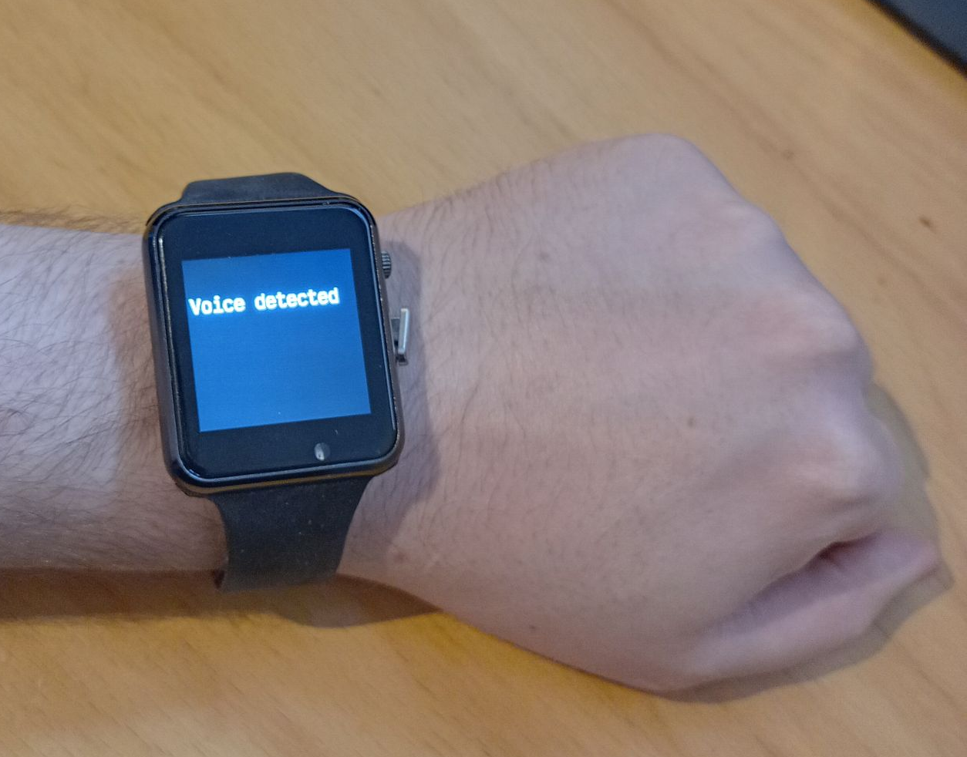
Using the C code
#include and call predict()
// Include the generated model code
#include "mynet_model.h"
// index for the class we are detecting
#define MYNET_VOICE 1
// Buffers for input data
#define N_FEATURES 6
float features[N_FEATURES];
#define DATA_LENGTH 128
int16_t sensor_data[DATA_LENGTH];
// Get data and pre-process it
read_microphone(sensor_data, DATA_LENGTH);
preprocess_data(sensor_data, features);
// Run the model
out = mynet_predict(features, N_FEATURES);
// Do something with results
if (out == MYNET_VOICE) {
set_display("voice detected");
} else {
set_display("");
}
setup
loop
Notes:
To use the code, include the generated header file.
Pass the data to the predict() call of the model.
The output can the be used to trigger relevant actions,
such as controlling motors, logging event that occur,
or sent an external system.
In this example, we just show the model output on a display.

Slide 10
Summary
1
Machine Learning is useful on microcontrollers Ex: extract information from sensors
2
emlearn is an open-source project with embedded-friendly ML algorithms
3
Makes it easy to deploy by generating portable C code
More information: https://emlearn.org
Notes:
...
You will find more information on emlearn.org

Slide 11
Notes:
Thank you for listening.
I hope you found it interesting and useful.

Slide 13
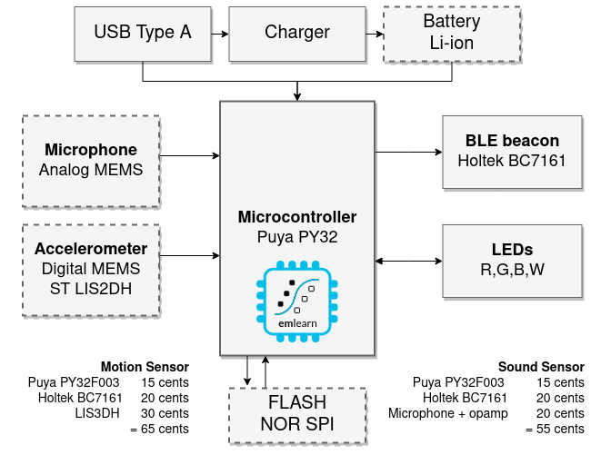
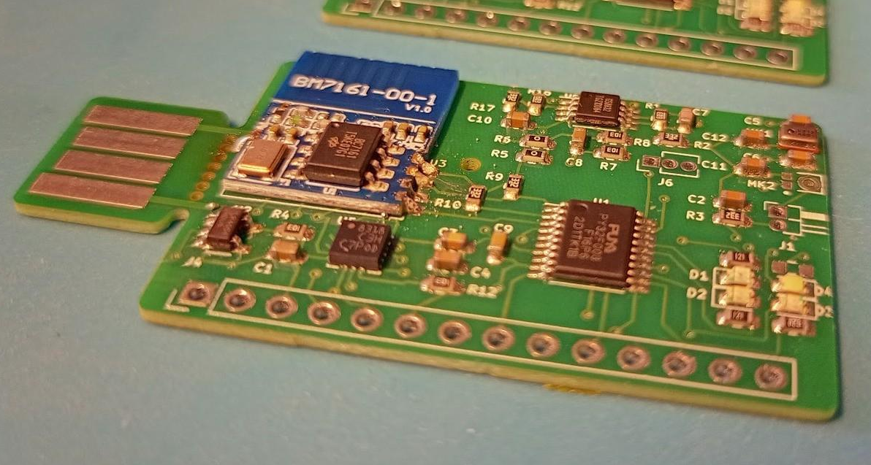
1 dollar TinyML system
Goal: Sound and accelerometer sensing using ML for under 1 USD in total component cost (BOM)
https://hackaday.io/project/194511-1-dollar-tinyml
Challenge: 3 kB RAM / 32 kB FLASH
Notes:
### Object detection

